Slide 1
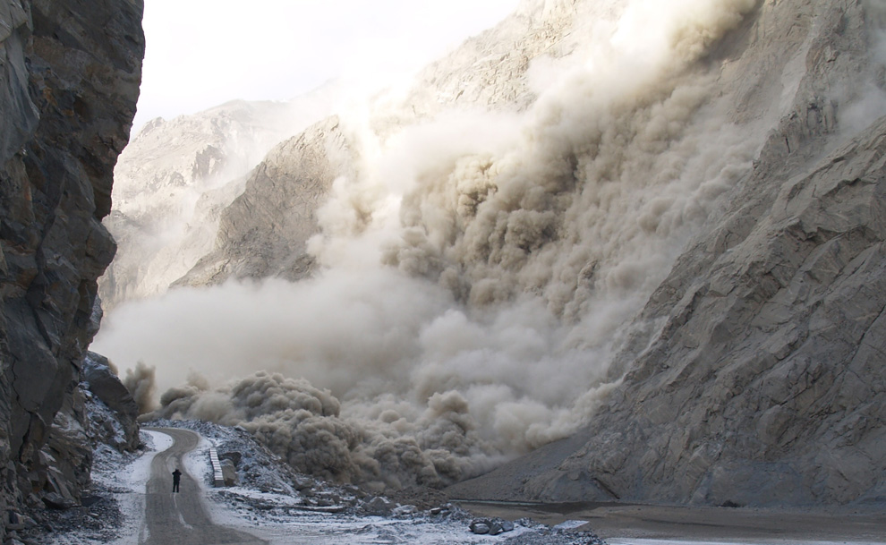
GLOBAL LANDSLIDE CATELOG REPORT
GROUP 4
BUSINESS INTELLIGENCE
Landon Lyle ID#200421088 ~ Faruk Furkan KOc ID#200471957 ~ Bridget Ndubuisi ID#200500724 ~ Mustafa Gorkem Guzeloglu ID#200477757 ~ Ashlesh Sheth ID#200491731

Slide 2

Agenda
Chosen Dataset
Pre-Processing
Dimensionality Reduction
Classification Technique
Our 3 Algorithms
Our 5 Questions
Conclusions

Slide 3
Chosen Dataset
Global Landslide Catalog Export
Metadata Updated: November 12, 2020
The Global Landslide Catalog (GLC) was developed with the goal of identifying rainfall-triggered landslide events around the world, regardless of size, impacts or location. The GLC considers all types of mass movements triggered by rainfall, which have been reported in the media, disaster databases, scientific reports, or other sources. The GLC has been compiled since 2007 at NASA Goddard Space Flight Center.
This dataset on data.nasa.gov was a one-time export from the Global Landslide Catalog maintained separately. It is current as of March 7, 2016. The original catalog is available here: →
Landslide Dataset

Slide 4
OUR APPROACH
LANDSLIDES DATA
PRE-PROCESSING
CONCLUSION
QUESTIONS
DIMENSIONALITY REDUCTION
ALGORITHMS
CLASSIFICATION TECHNIQUE

Slide 5
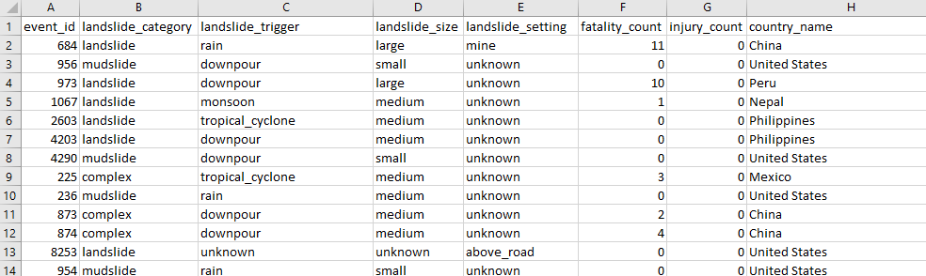
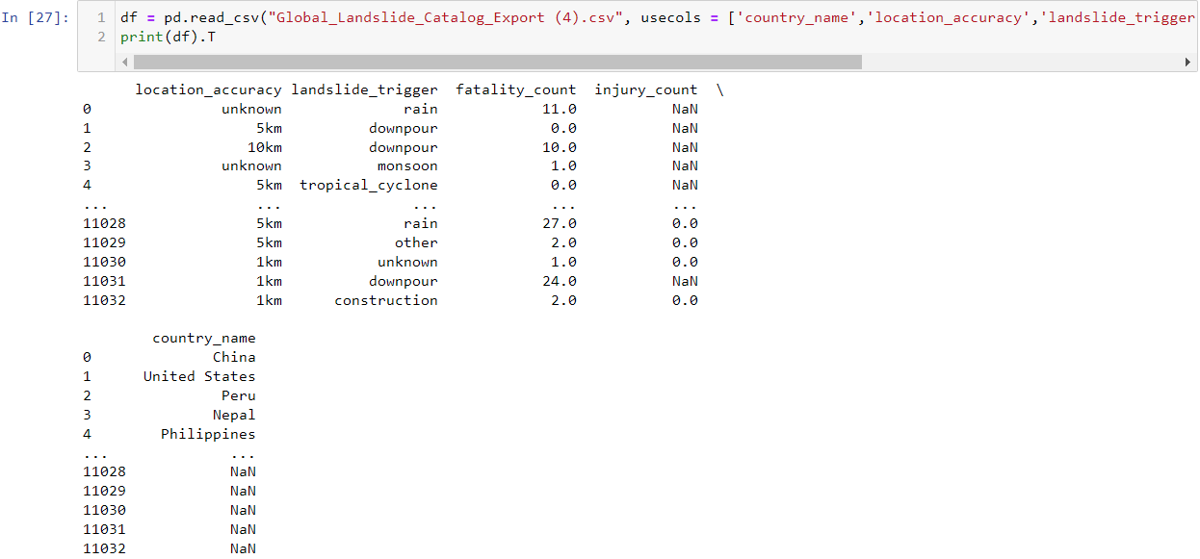
Pre-Processing
Data preprocessing in Machine Learning refers to the technique of preparing (cleaning and organizing) the raw data to make it suitable for a building and training Machine Learning models.
EXCEL
PYTHON
This can be accomplished in Excel before loading dataset in Jupyter Notebook. By just deleting the columns that are not needed. And to replace missing values with zeros.
This can be accomplished in Jupyter Notebook also by selecting the columns we want from dataset and replacing null values with our own value.

Slide 6
Dimensionality Reduction
Using dimensionality reduction techniques, we used this concept to reduce the number of features in our landslide dataset without having to lose much information and keep (or improve) the model’s performance.
There are 31 columns in this dataset described below.
DATA TYPES | COUNT | NOMINAL OR ORDINAL | QUALATATIVE DATA
Numerical Data Types | 8 | 7 Nominal / 1 Ordinal | EVENT_ID
Categorical Data Types | 5 | 4 Nominal / 1 Ordinal | LANDSLIDE_SIZE
Geographical Data Types | 2 | 2 Nominal | LATITUDE / LONGITUDE
Text Data Types | 19 | 19 Nominal / 1 Ordinal | LANDSLIDE_SIZE
Time Format | 4 | 4 Nominal
Our primary focus will be on (landslide_events, landslide_size, landslide_triggers, landslide_category, countries & fatalities) the rest of the columns in the dataset will be excluded to reduce our features.

Slide 7
Classification Technique
A common job of machine learning algorithms is to recognize objects and being able to separate them into categories. This process is called classification, and it helps us segregate vast quantities of data into discrete values, i.e. :distinct, like 0/1, True/False, or a pre-defined output label class.

Slide 8
Our 3 Algorithms
Decision Tree
MODEL 1
The goal of using a Decision Tree is to create a training model that can use to predict the class or value of the target variable by learning simple decision rules inferred from prior data(training data).
Linear Regression
MODEL 2
Linear Regression is one of the machine learning algorithms where the result is predicted by the use of known parameters which are correlated with the output. It is used to predict values within a continuous range rather than trying to classify them into categories.
Logistic Regression
MODEL 3
Logistic regression is a statistical analysis method to predict a binary outcome, such as yes or no, based on prior observations of a data set. A logistic regression model predicts a dependent data variable by analyzing the relationship between one or more existing independent variables.

Slide 9
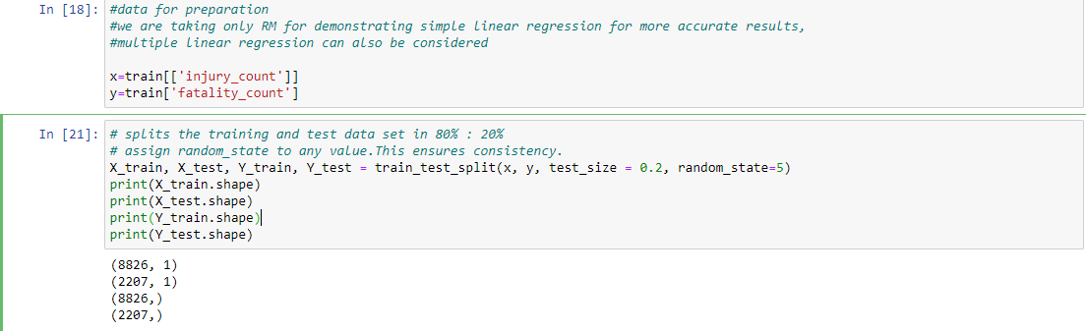
Data Training
In the code below we train the data, we give %80 of data for training and %20 of data for testing.
So we can have more accurate results.

Slide 10
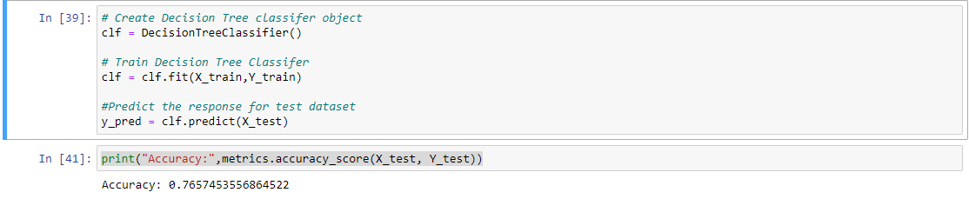
MODEL 1:Decision Tree
We compared the relationship between injury count and fatality count using Decision Tree as our first model.
In the code below you can see the accuracy of decision tree model.
Accuracy score was found equal to 0.76.
According to the results, if the number of death in a landslide is high, the number of injured people
also high at the rate of 76%.

Slide 11
MODEL 2:Linear Regression
We compared the relationship between injury count and fatality count using Linear Regression as our second model.
In the code below you can see the accuracy of Linear Regression model. According to results we can not rely on the
accuracy of this model. Knowing the number of dead in the landslide area does not allow us to estimate the number of injured people.

Slide 12
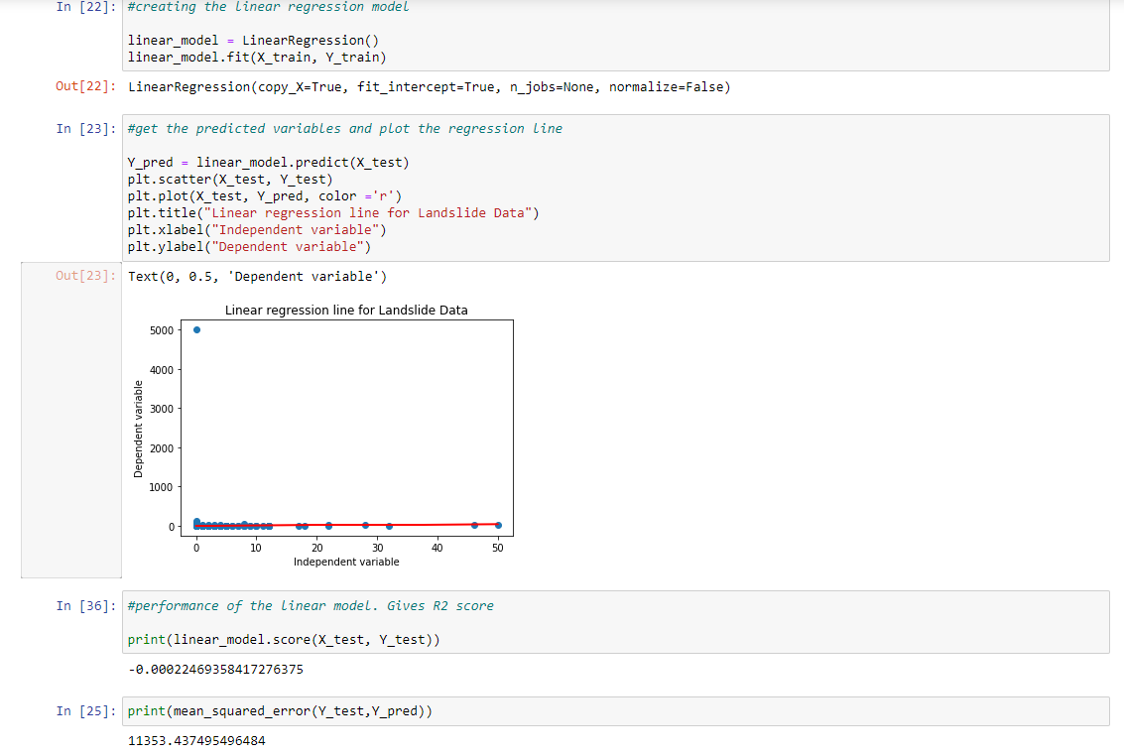

Slide 13
MODEL 3:Logistic Regression
We compared the relationship between injury count and fatality count using Logistic Regression as our third model.
In the code below you can see the accuracy of Logistic Regression model.
Accuracy score was found equal to 0.77. We got results closer to Decision Tree model.
To sum up, using Decision Tree model and Logistic Regression model gives us better results than Linear Regression
model.

Slide 14
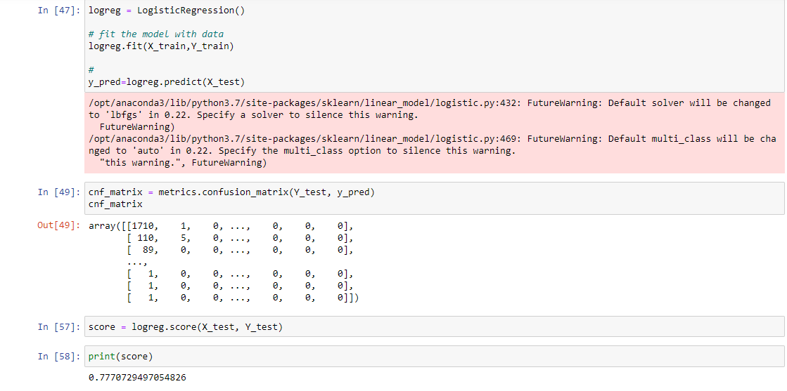

Slide 15
OUR FIVE QUESTIONS
Q1 | Q2 | Q3 | Q4 | Q5
According to the countries, which reasons were the most common causes of landslides? | In which year were the most landslide seen around the world? | Do landslide settings and landslide triggers have a common relationship to the number of fatalities caused? | Which landslide trigger defined by landslide category caused the most fatalities? | Which country reported more rainfall-triggered landslide event?
“These will be the questions we will attempt to answer throughout our analysis.”

Slide 16
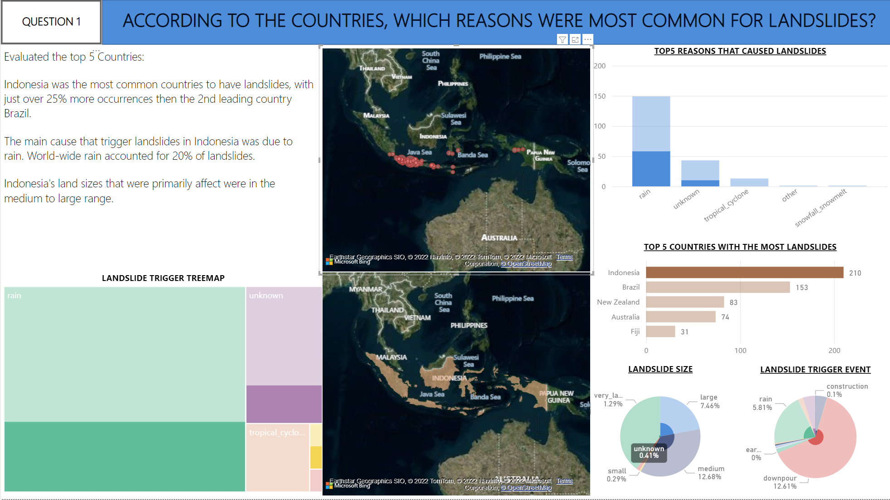
ANSWER FOR QUESTION # 1

Slide 17
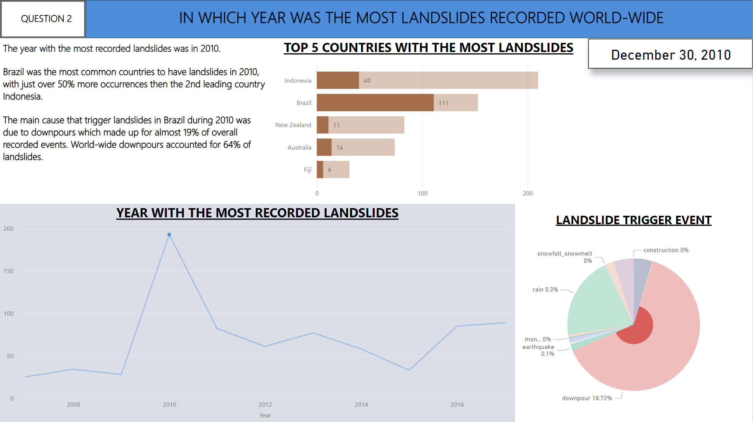
ANSWER FOR QUESTION # 2

Slide 18
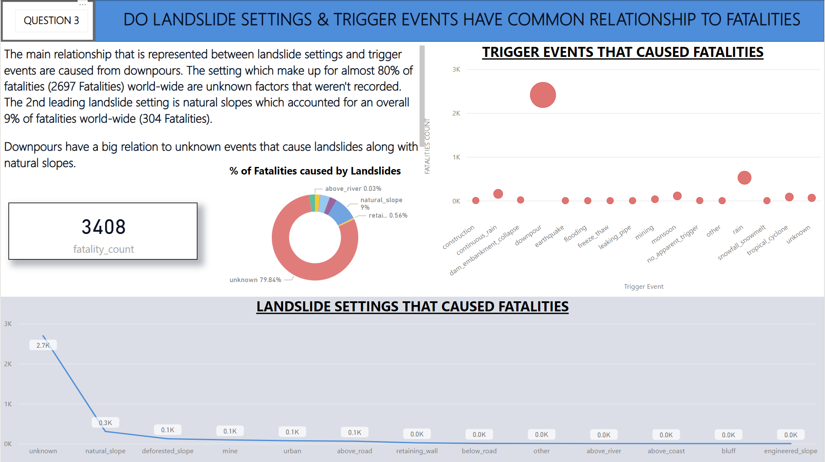
ANSWER FOR QUESTION # 3

Slide 19
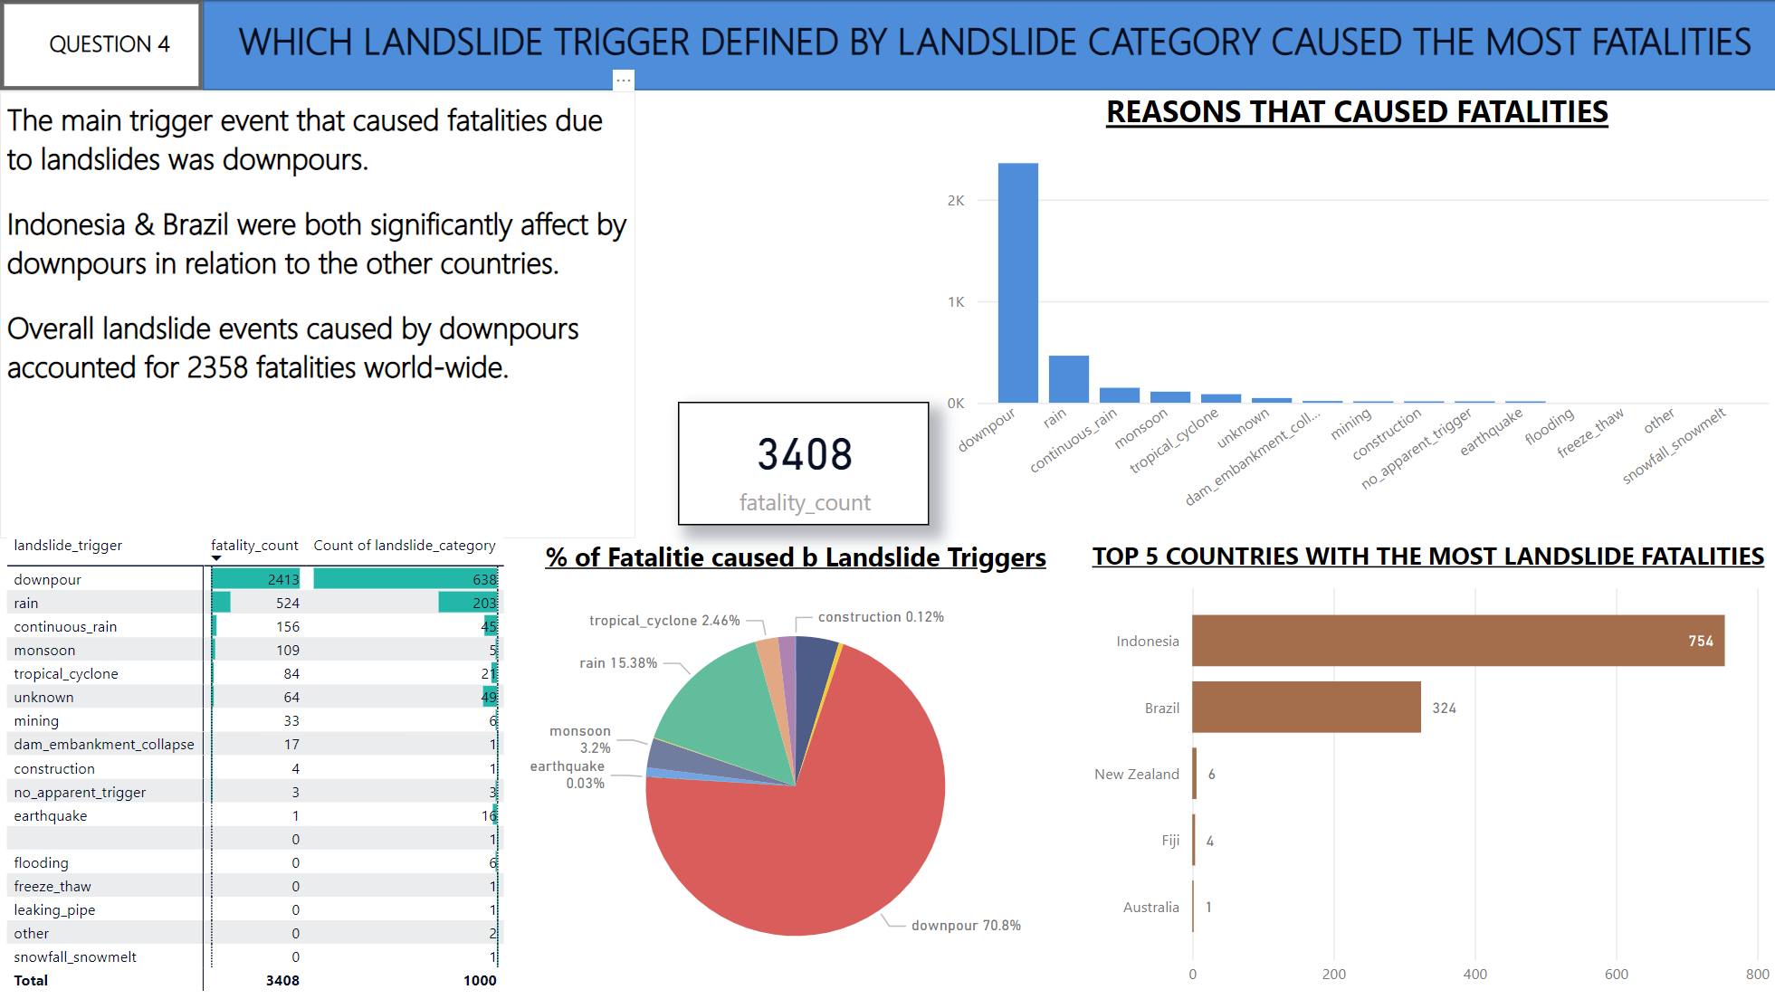
ANSWER FOR QUESTION # 4

Slide 20
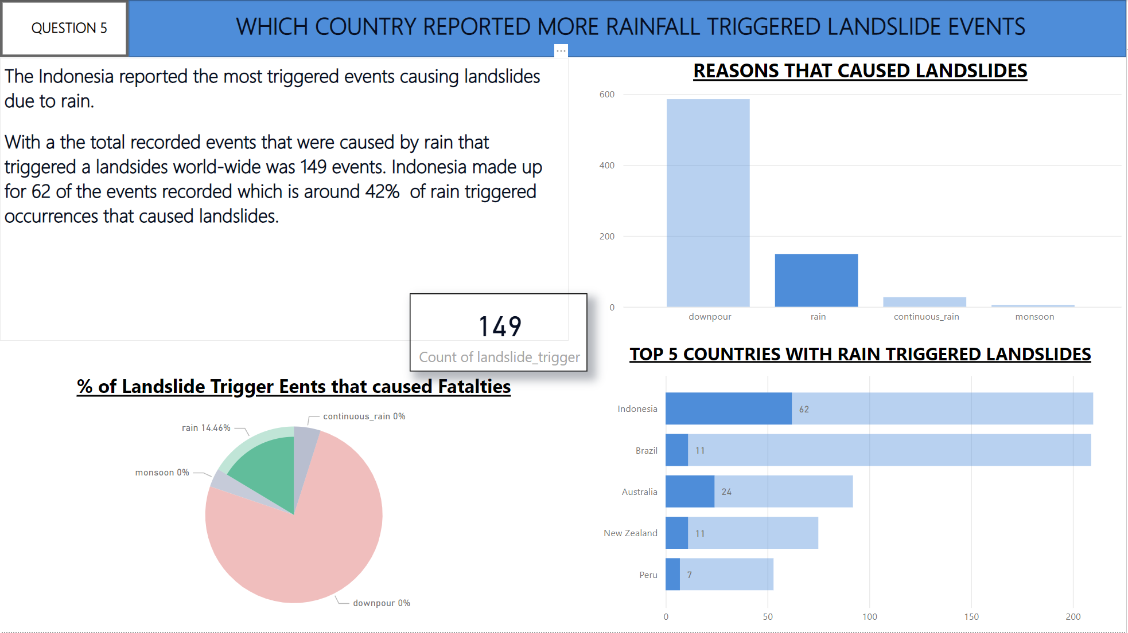
ANSWER FOR QUESTION # 5

Slide 21
POWER BI PRESENTATION
GROUP 4

Slide 22
CONCLUSION
This project outlines the methodology used to analyze the dataset; Global Landslide Catalog report (GLC) based on media reports, online databases, and other
sources. We investigated trends in landslide activity from 2007 to 2017.
The GLC report was used to understand patterns of landslide occurrence and to answer the questions we had. Variables including rainfall, unknown factors, landslide settings were used. This analysis shows relationship between landslide settings and trigger events like extreme rainfall, unknown factors that caused landslide fatalities.
We can see from the analysis that extreme rainfall(downpour) was the major trigger for landslides which accounted for 20% world-wide fatalities. Indonesia being the most affected with landslides with approximately 25% more occurrences than Brazil out of global landslides, Brazil came second in this category, New Zealand is the third most affected, followed by Australia, lastly Fiji. The most recorded landslide happened in 2010 with downpour accounting for 18.7%.
Indonesia reported the most triggered events causing landslides due to rain. A total of 149 events, it made up 62 out of these events.
Conclusively, with additional years of data and improved accuracy in reporting, the GLC can provide a key database for improving the global picture of landslide
susceptibility.

Slide 23
THANK YOU
Landon Lyle ID#200421088
Faruk Furkan KOc ID#200471957
Bridget Ndubuisi ID#200500724
Mustafa Gorkem Guzeloglu ID#200477757
Ashlesh Sheth ID#200491731

